Slide 1

My Portfolio CPT
BY: Prince Moore

Slide 2
Reflection 1
I had to collaborate with someone on this assignment. My partner and I used graphic design, for example. Using text characteristics in photos, for instance. you may make presentations straight in your web browser. Every edit is instantly saved when you and your team work together on slides at the same time. This allows you to view changes as they are made.

Slide 3
Reflection 2
With this piece of work, I was able to use my web browser to generate and update spreadsheets without the need for additional applications. It may also be used by many individuals at once, and all changes are instantly stored. You can view changes as they are made.

Slide 4
Reflection 3
Regarding the task Canva is a priceless tool for improving your design abilities. You can use it for everything from social media photos, videos, and gifs to posters, websites, booklets, multimedia presentations, and much more. Canva was generally easy to use.

Slide 5
Reflection 4
I can produce and edit text documents using this piece of work directly in your web browser; no further software is needed. Better still, you can work with numerous individuals at once, see changes as they are made, and every modification is instantly stored.

Slide 6
Catholic Graduate Expectations
Lifelong Learner

Slide 7

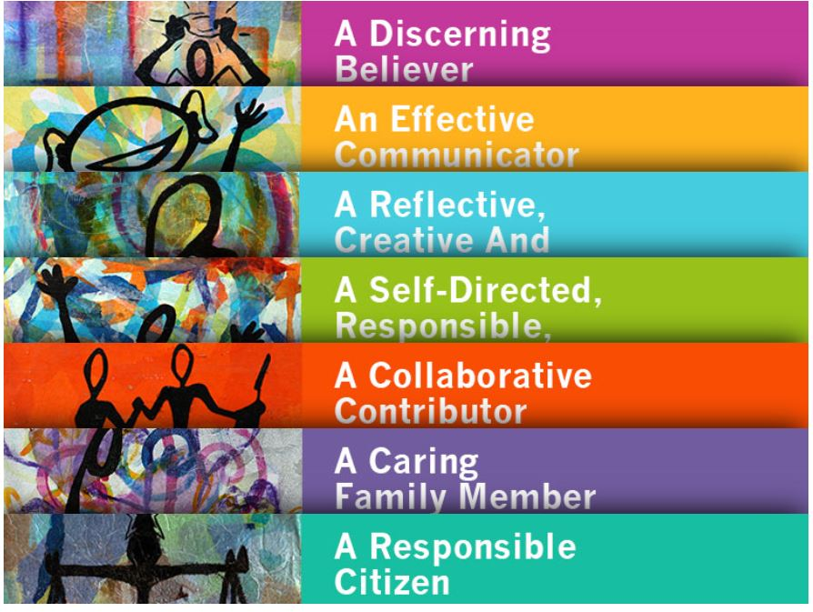
Catholic Graduate Expectations
Definition of lifelong learner Self-directed, Responsible, Lifelong learner - who develops and demonstrates their God-given potential.
Through this unit of this course I feel as though I have became a lifelong learner witch is someone that has the purpose or call in life that comes from God and strives to discern and live out this call throughout life's journey. Respects the faith.

Slide 8
Thank You for listening to my presentation

